Slide 1
GIS HMI MODERNIZATION
KSOE, Korea
CHRISTOPH Sterz

Slide 2
Detailed Workshop Agenda – Overview
화요일
TUE
수요일
WED
목요일
THU
금요일
FRI
Morning
& Noon
Welcome
Advanced
Qt
Rust / Slint
Flutter
Identifying Needs and Work Items
for the Modernization
Comparison of the 3 GUI Frameworks
for KSOE GIS
Introduction to
Qt
Rust / Slint
Flutter
Input: Less Technical
All Hands
Embedded GUI
Development
Other Existing GIS Applications
Reviewing the Existing KSOE GIS Application
(Panel & Web)
Presenting and Comparing the POC Implementation
PC & Embedded
HighLevel Plan
for new GIS,
NextSteps KSOE
Afternoon
Info: More
Technical
Decision

Slide 3
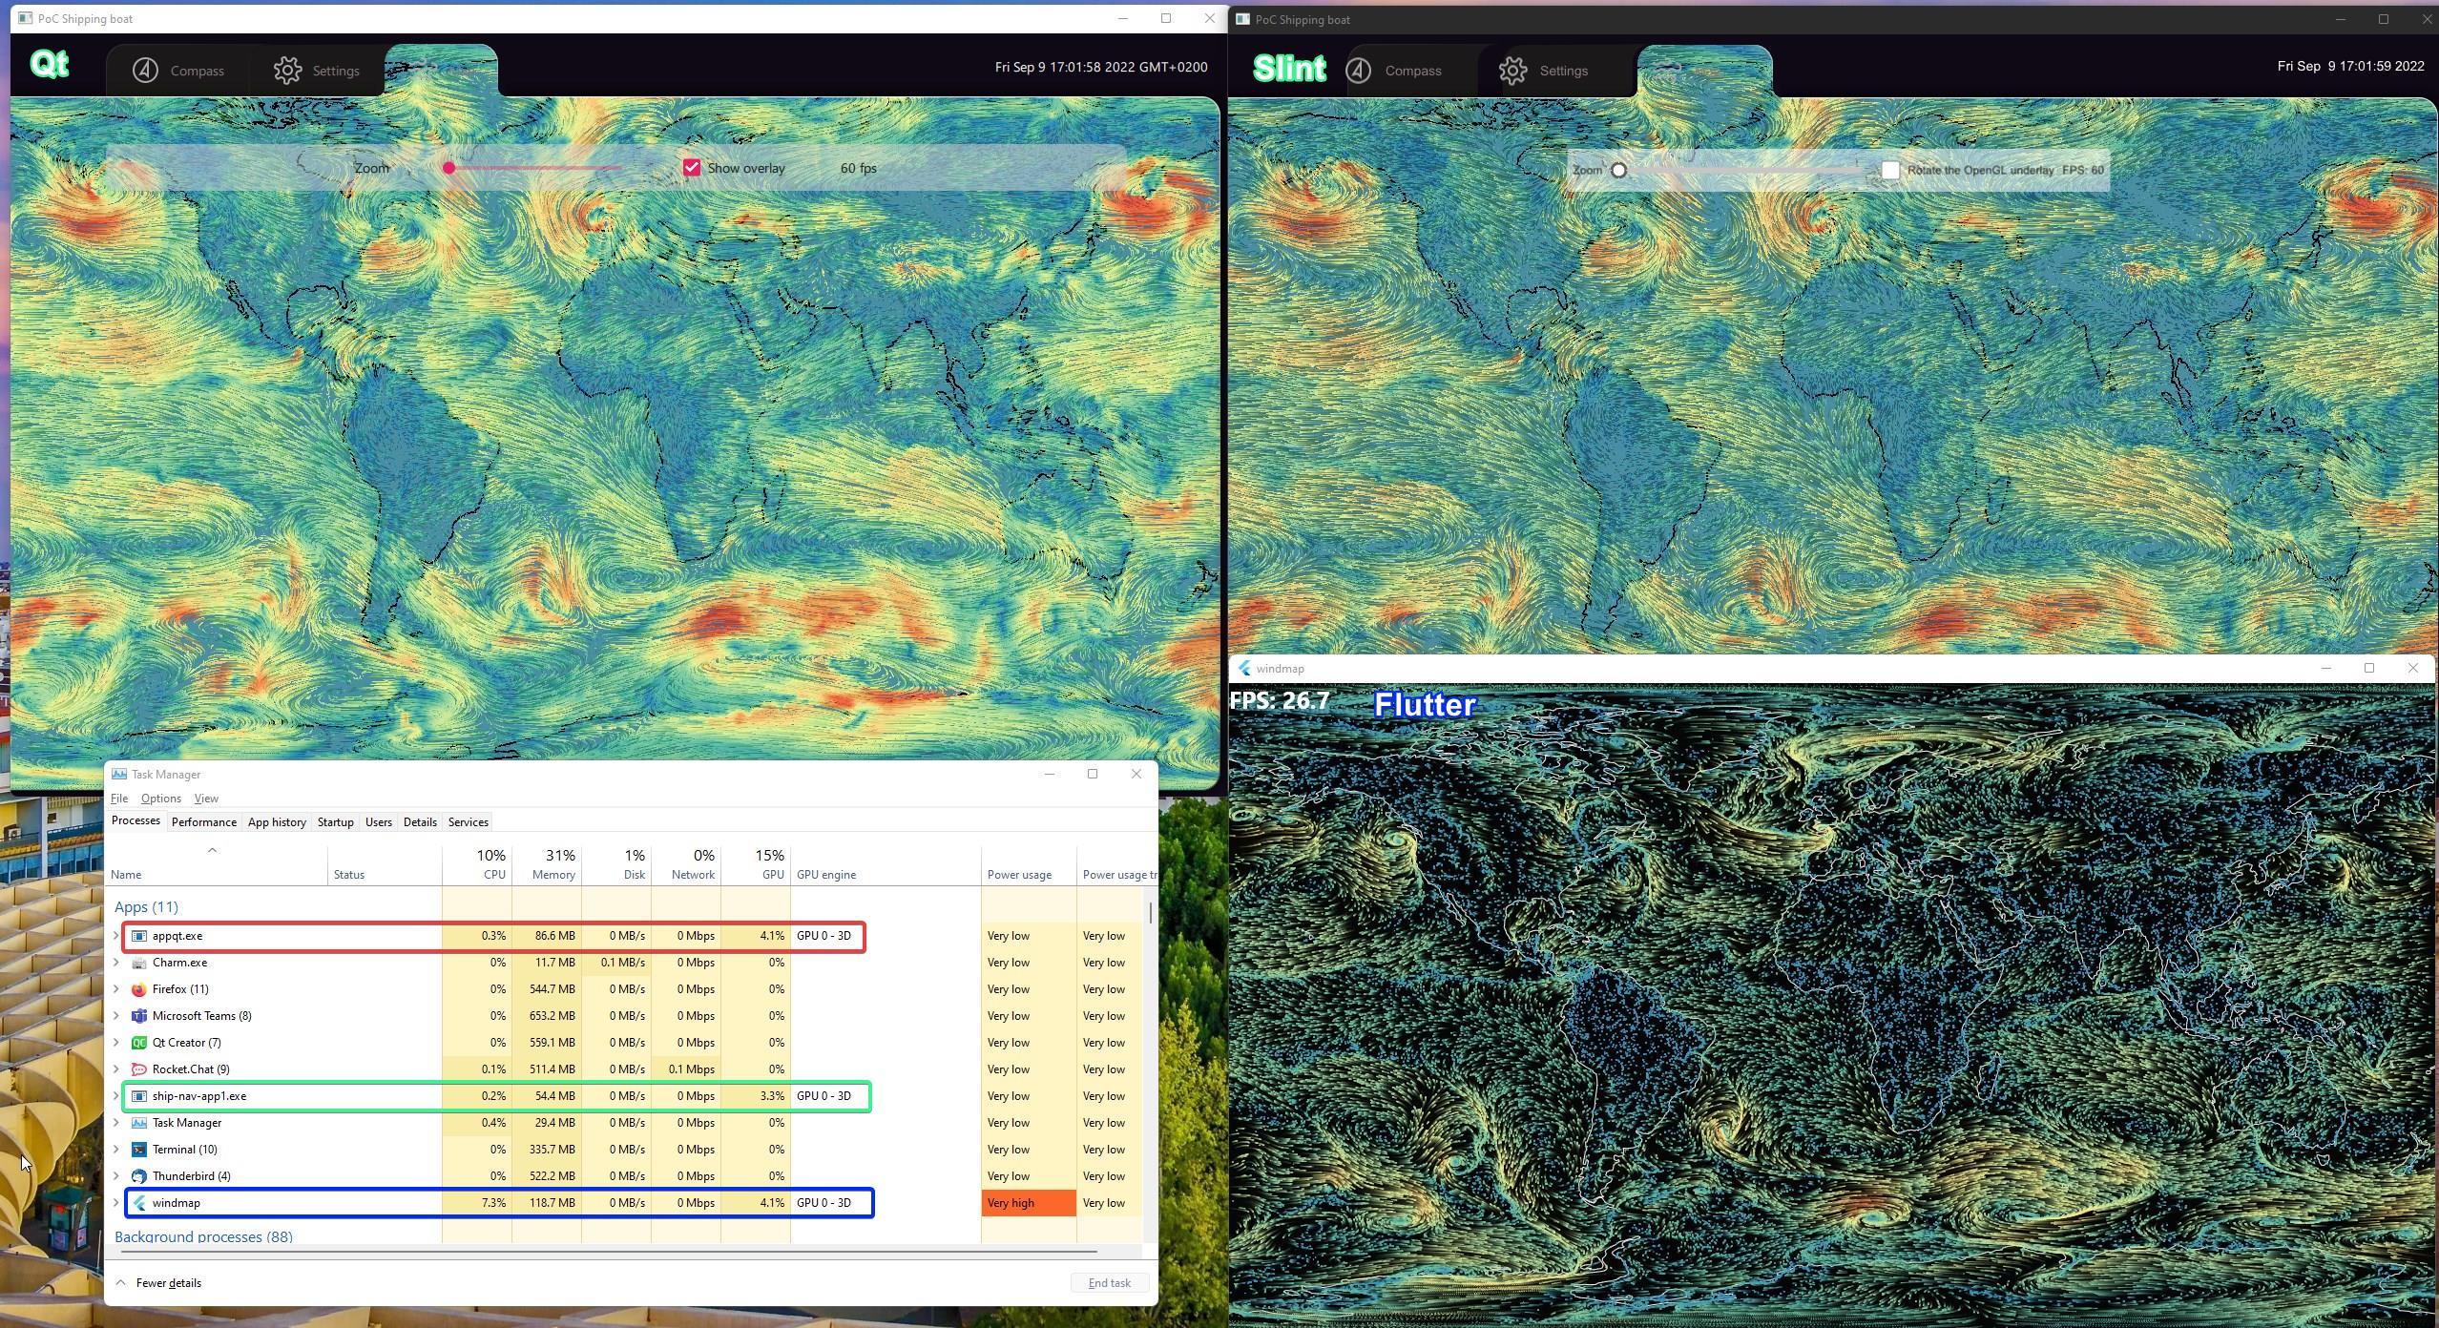
On Windows

