Slide 1
Introduction to
GUI Frameworks: Qt Slint Flutter
KSOE, Korea
CHRISTOPH Sterz

Slide 2
Detailed Workshop Agenda – Overview
화요일
TUE
수요일
WED
목요일
THU
금요일
FRI
Morning
& Noon
Welcome
Advanced
Qt
Rust / Slint
Flutter
Identifying Needs and Work Items
for the Modernization
Comparison of the 3 GUI Frameworks
for KSOE GIS
Introduction to
Qt
Rust / Slint
Flutter
Input: Less Technical
All Hands
Embedded GUI
Development
Other Existing GIS Applications
Reviewing the Existing KSOE GIS Application
(Panel & Web)
Presenting and Comparing the POC Implementation
PC & Embedded
HighLevel Plan
for new GIS,
NextSteps KSOE
Afternoon
Info: More
Technical
Decision

Slide 3



Contents
This Presentation will introduce the 3 GUI Frameworks
  Qt
  Flutter
  Slint
The KSOE POC was implemented 3 Times (For each Framework)
This presentation introduces History, Languages, and UI concepts
The Information will guide KSOE engineers and management

Slide 4
History - Overview
QML
Qt4
2004
Qt5
2012
Qt6
2020
Dart
2011
Flutter
2017
Software & GUI
Frameworks
Rust
2010
Slint
2020
iMX6
2011
iMX8
2017
Hardware
X2 Panel Release
2016

Slide 5
Qt is the Oldest
QML is medium-old
Qt is by far the oldest GUI Framework (1995)
Qt ist based on the programming Language C++ (1985)
Almost all Qt Touch-GUIs are programmed in QML (2011)
There is the option of programming in python instead of C++ since 2019.
Qt Changed Owner Multiple times
    1991 – 2008 Trolltech
    2008 – 2011 Nokia
    2011 – 2014 Digia
    2014 – Now The QtCompany

Slide 6
Qt Program Architecture
Qt is Cross-Platform. (Windows, Linux, Mac, (WinCE), QNX, (VXWorks), (Integrity), (MCU))
Qt Libraries can perform almost all OperatingSystem Tasks
  Network Access
  Sound, Bluetooth, …
  Device Access
  File Access
  Drivers (CAN, Modbus, …)
QML UI-Programming
C++ Logic
C++ Logic
QML Engine
Qt Libraries
Qt Libraries
Operating System (Windows, Linux, Mac)

Slide 7
Qt Widgets on Desktop
Qt QML on Embedded
Faster, Destkop PC, Mouse+Keyboard
Slower, Embedded Hardware, Touchscreen
Widgets
QML

Slide 8
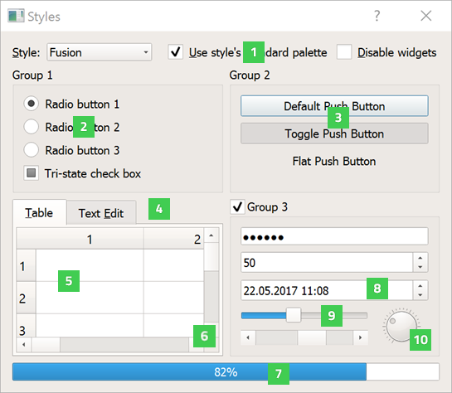
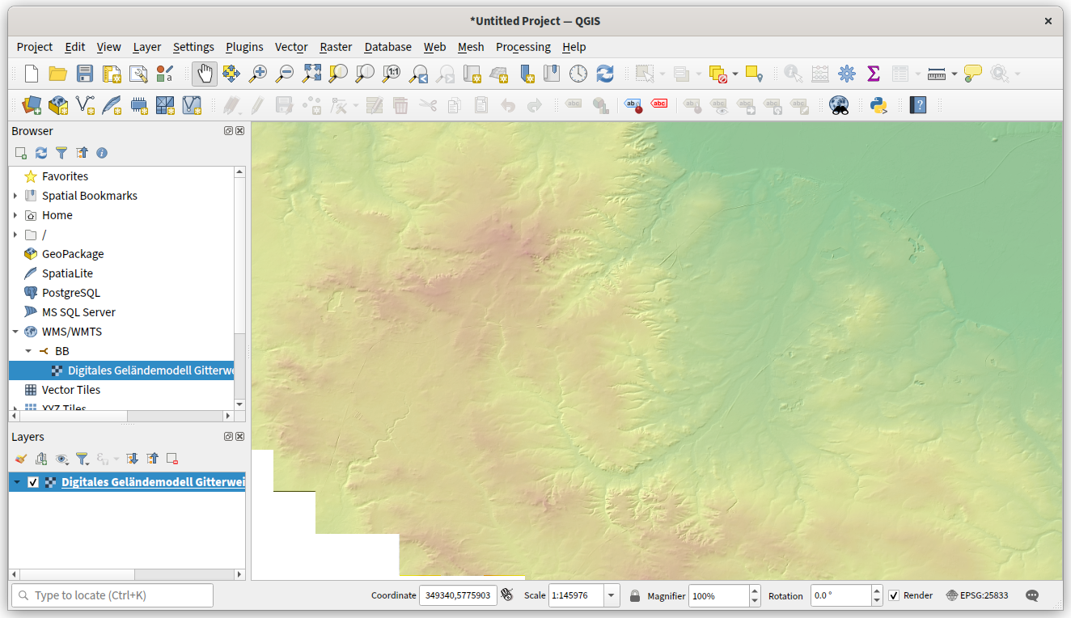
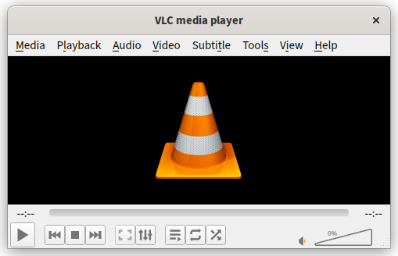
Qt Example Programs
Qt Widgets on Desktop
Widget Gallery
QGIS
VLC Player

Slide 9
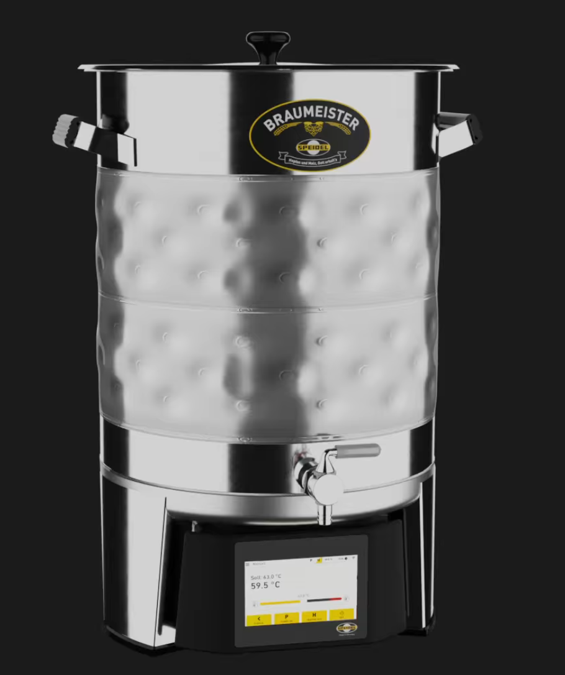
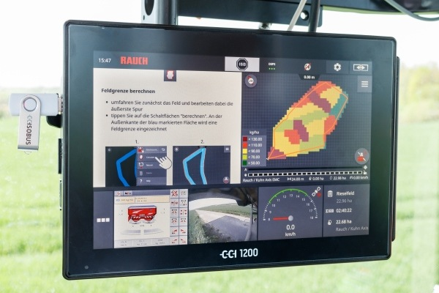
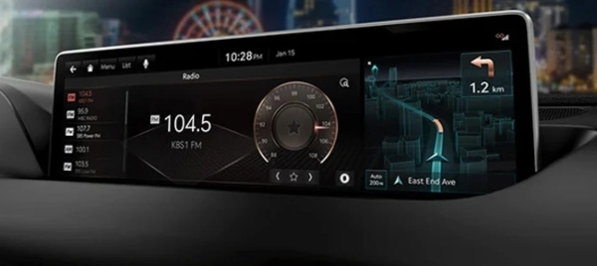
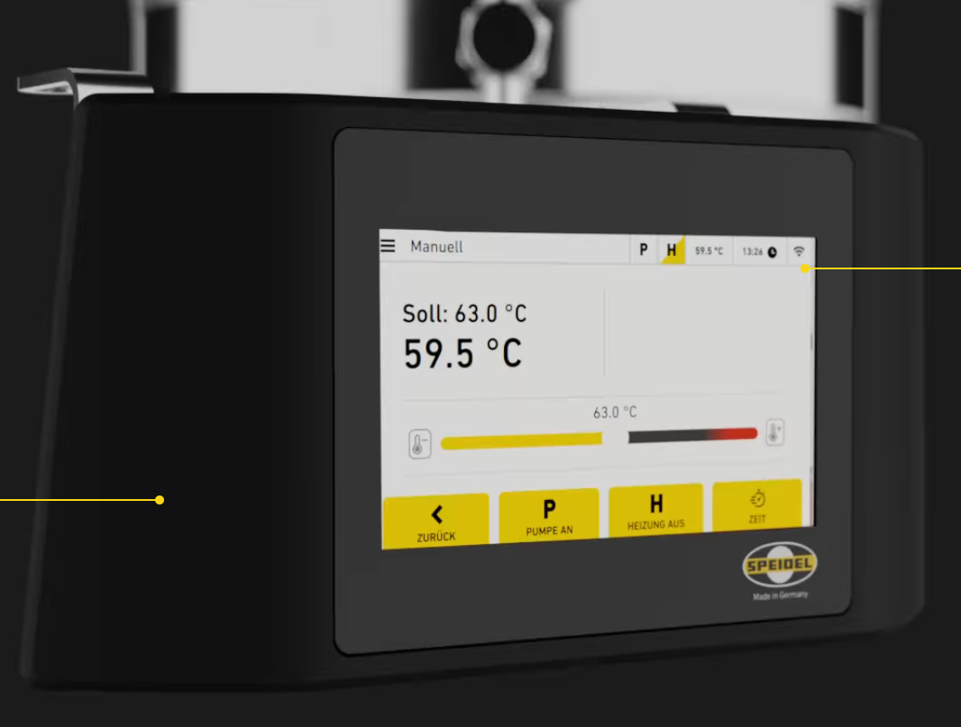
Qt Example Programs
Qt QML on Embedded
Hyundai Genesis Car
Farming / Tractors
Braumeister Beer Brewing

Slide 10
The Qt Embedded Programmer
Needs to know 2 Languages: C++ and QML
C++: High-Performance Datahandling and Business Logic
  Programmer will talk to the Backend-Programmer
  Access and Pre-process Datasources, Inform Backend about Changes in Data
QML: The Looks – UI only
  Programmer will talk to the Designer
  Screens, Elements, Colors, Animations

Slide 11
C++ And QML
C++: Data and Logic
QML: The Looks
//(C++)
InitializeSystem(…);
ReadMapData(…);
GetPosition(…);
DisplayBrightness(…);
GetWeather(…);
Update(…);
Reboot(…);
// QML
Window {
TitleBar {
Clock {…}
}
MainMap {
ShipMarker{…}
}
BottomBar {
InfoLine{…}
}
}

Slide 12
Compile Process
Test On Desktop (fast)
Test On Hardware (slow)
.h /.cpp
(C++)
.qml
(QML)
.h /.cpp
(C++)
.qml
(QML)
Qt
SDK
Cross-Compiler
Compiler
Copy
Check on
Desktop
Check on
Desktop
Check on
X2-Panel

Slide 13
Flutter
Started in 2015
But really made usable in 2018
The most important aspect to know about flutter is, that its supported by Google.
  This is good: A lot of free, high-quality maintainance flows into the language, graphics, elements
  But this is also bad: Google has a bad history of abandoning technologies.
  My Prediction: Google-Flutter-Support will safely stay for 5 years but after that anything is possible.

Slide 14
Flutter is designed for Mobile Phones
This is what Flutter is most used for:
Android and iOS Applications
It works on Embedded because it build in a Plugin-Way:
  So-Called Embedders make it possible to run the same Bundle on a different Platform, An Engine is also needed which must be compiled for the same platform
App
(FlutterBundle)
App
(FlutterBundle)
iOS Embedder
Flutter
Engine
Android Embedder
Flutter
Engine
iMX6 (X2)
Embedder
Flutter
Engine

Slide 15
The Flutter Programmer
Writes Logic Code and UI Design into the same source file
Different Classes…
…Do more Logic (States)
…Or more UI (Widgets)
Is very much supported by Refactoring Tools and IDEs
(see this soon in the Hello World examples)
Code looks very complex but the tools make it work well

Slide 16
Flutter Code
// .dart
import 'package:flutter/material.dart';
void main() {
runApp(… MyApp());
}
class MyApp … {
Widget build(BuildContext context) {
return const MaterialApp() {
Widget {
Widget {…}
Widget {…}
}
}
}
Android Files
C++ Files
All autogenerated, not directly edited
Apple
XCode Files

Slide 17
Slint (&Rust)
Really founded in 2020
Maintained by smaller Slint Company and active Rust Community
Modern and versatile
Very similar to C++ and QML – but more modern
Rust as a base is a very safety-oriented language
  Last week Rust Code was accepted as Part of the Linux Kernel
  Many Programmers like to learn Rust

Slide 18
Rust And Slint
Rust: Data and Logic
slint: The Looks
//main.rs
slint::include_modules!();
fn main() {
let ui = AppWindow::new();
let ui_handle = ui.as_weak();
on_button_clicked(…){…};
ui.run();
}
// .slint
Window {
callback on_button_clicked()
VerticalBox {
Header {…}
MainMap {
ShipMarker {…}
}
Button {
…
}
}

Slide 19
Rust And Slint
Rust: Data and Logic
slint: The Looks
//main.rs
slint::include_modules!();
fn main() {
let ui = AppWindow::new();
let ui_handle = ui.as_weak();
on_button_clicked(…){…};
ui.run();
}
// .slint
Window {
callback on_button_clicked()
VerticalBox {
Header {…}
MainMap {
ShipMarker {…}
}
Button {
…
}
}

Slide 20
JS And Slint
JS: Data and Logic
slint: The Looks
//main.js
// .slint
Window {
callback on_button_clicked()
VerticalBox {
Header {…}
MainMap {
ShipMarker {…}
}
Button {
…
}
}

Slide 21
C++ And Slint
C++: Data and Logic
slint: The Looks
//main.cpp
// .slint
Window {
callback on_button_clicked()
VerticalBox {
Header {…}
MainMap {
ShipMarker {…}
}
Button {
…
}
}

Slide 22
Slint uses Rust-Cargo
Cargo is a great packagemanager – compiling slint/Rust
“Cooking Recipe”
//.rs
// .slint
Cargo.toml
Gets
all
Dependencies
Cargo
Embedded app
Web assembly
Native program

Slide 23
Slint works well on weak Hardware
Slint can be compiled for MCUs which don’t even have an Operating System
Systems with high volumes require very cheap hardware to be mass-produced
MCUs could not offer freely programmable Languages before (programs were more or less fixed screens)
With Slint, MCUs can be freely programmed

Slide 24
Qt, Flutter, Slint
Existing UI Components
All 3 Frameworks offer basic UI Components to be used. (Buttons, Labels, Sliders)
Qt has a good UI Library, accessible also with Keyboard
Flutter has a good UI Library, but very poor Keyboard Support
Slint has only basic UI Elements, but writing new Elements is easy and KSOE GIS will require its own look anyways.
For all 3 Frameworks, KSOE needs to develop a Toolbox of own Elements.

Slide 25
Qt, Flutter, Slint
And the Web (WASM)
All 3 Frameworks can in principle be compiled to Webassembly (WASM) and can be watched as a Webpage.
Compiling to web requires Programmers to leave out parts or implement them differently
  OS-Calls become web APIs
  Network becomes WebSocket
  Multithreading is not supported
  Videos and shaders might not work

Slide 26
Qt, Flutter, Slint
And the Web (WASM)
A company really has to think hard about 3 Options:
  (Really) Expensive Hardware: Allows Web on all Platforms
    It is not possible to run advanced UIs on IMX6 Chrome!
  Expensive Hardware: Have native app in embedded + same Code compiled to WSAM Web (but WASM-Web is potentially not fully functional)
  Cost-Effective Hardware: Have native app on embedded + HTML5 in Web (requires 2x Programming the Software)

Slide 27
Overview
QML
Qt4
2004
Qt5
2012
Qt6
2020
Dart
2011
Flutter
2017
Software & GUI
Frameworks
Rust
2010
Slint
2020
iMX6
2011
iMX8
2017
Hardware
X2 Panel Release
2016

Slide 28
Interactive HelloWorld
At the End of this Presentation I will present a simple Hello World in all 3 Languages and show how the programming looks and feels like
Goal: 1 Text + 1 Button, Text has a number counted up
Times Button pressed: 2
Press!

