Slide 1
GIS HMI Embedded Aspects
KSOE, Korea
CHRISTOPH Sterz

Slide 2
Detailed Workshop Agenda – Overview
화요일
TUE
수요일
WED
목요일
THU
금요일
FRI
Morning
& Noon
Welcome
Advanced
Qt
Rust / Slint
Flutter
Identifying Needs and Work Items
for the Modernization
Comparison of the 3 GUI Frameworks
for KSOE GIS
Introduction to
Qt
Rust / Slint
Flutter
Input: Less Technical
All Hands
Embedded GUI
Development
Other Existing GIS Applications
Reviewing the Existing KSOE GIS Application
(Panel & Web)
Presenting and Comparing the POC Implementation
PC & Embedded
HighLevel Plan
for new GIS,
NextSteps KSOE
Afternoon
Info: More
Technical
Decision

Slide 3
Contents
A Typical Embedded Project
On Embedded: Do not forget:
  Virtual Keyboard
  Performance
  Updates
  Translations
Easy Cross-Platform Development
LiveSession: Deploying Qt | Flutter | Slint – to an Embedded board

Slide 4
Typical Embedded Project
1. Planning and Certification
The Company must make sure the products they have are legal and can be sold in the target market
2. Hardware Planning before Software
Number of products defines price, defines Hardware-Savings per piece, If High Numbers, software cost drops relatively, cheaper hardware is used and more is spent on software
(One Customer, 30Milion Devices, very cheap HW, every 1000KRW saved per device are 30.000.000.000 KRW saved in the project!)

Slide 5
Typical Embedded Project
3. Start of Software-Development: Not enough Hardware
Usually there are not enough test machines for the whole team at the start. So the team works on Desktop Simulator only.
4. Management sees Product for the first Time
On Embedded that means UI changes come now. → Visual Items were planned to small for touchscreens, Items get bigger, less free Space.
5. Towards Start of Production (SOP)
All Software-Parts come together on the Hardware: Performance becomes problematic, ← programmers do “dirty hacks”.

Slide 6
Typical Embedded Project
6. Hardware in the Field
There will be crashes at the customer, It is important that Users will have some way of reporting errors. Phonecall is the worst, Crashreport is the best.
7. End Of Life
For some projects, it is possible that the Software is removed from the Market (e.g. legal Requirements, Own newer Product,…) Think if you have this situation, and how to react to it.

Slide 7
Typical Embedded Project
App
Application Layer
RPC Mechanism
(MQTT, protobuf)
Unix
Domain Socket
Process
Invocation
IPC Layer
Backend
Backend
SQlite
System
Services
System Layer
Linux
PLC
Other PC
Sensors
GPU
Driver
OS Layer
HW Platform
HW Platform

Slide 8
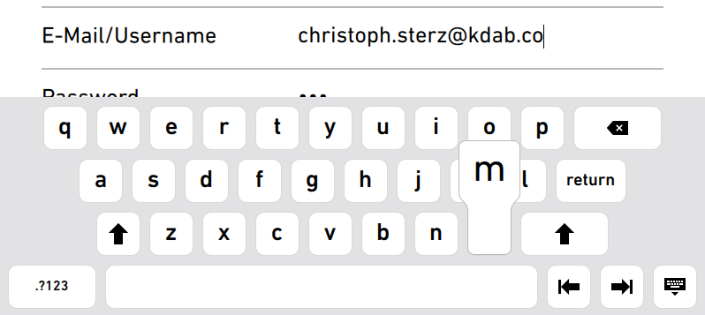

Touchscreen Special1: Virtual Keyboard

Slide 9
Touchscreen Special1: Virtual Keyboard
On Touchscreens, we need a Virtual Keyboard to enter text.
  Touch Keyboards are hard to build
  Input Methods for Hangul maybe need to be existing.
The Keyboard has about 100 Buttons and can become the Performance Problem #1 in Loading the Application
  Always try to load the Keyboard as late as possible!

Slide 10
Performance
Performance defines your companies face towards your users more than the UI-design!
In the flight to Korea, our Inflight-Entertainmentsystem was very slow, I do not understand Korean, but I understood my neighbors talking all the time about the Airline Lufthansa, pointing at the very slow screen.
  Fast feels easy, even if its complex.
  Slow feels hard, even if only 3 UI screens exist.

Slide 11
Updates
Nowadays, an A / B Update System is recommended if enough storage exists
(active)
(updated next)
Hardware flash
Linux Image A
Linux Image B
User Data Partition
Update
(standby, activates
after 3 fails of B)
(new active)
Hardware flash
Linux Image A
Linux Image B
User Data Partition

Slide 12
Translations
Apps can be live-transleable for different Users of the software
Some GUI Frameworks (Qt, Flutter) support Right to Left Layouts for Arabic, Hebrew, etc.
Input Methods are needed for Hangul, Chinese…

Slide 13
Easy Cross Platform Development
The setup for Developers must be as easy as possible:
Provide 1-Click Deployment from Desktop to Hardware.
Provide an SDK! + Provide an IDE (e.g. VS Code / Qtcreator) with 1-Click deployment
Benefits:
  Saves time for the thousands of test-runs a developer does
  (think of 1 minute saved x1000 per Developer)
  If deployment feels fast, then Developers test more, try out more, and fix more details
Provide Nightly Test Images from your CI!

Slide 14
Hands On: Qt | Flutter | Slint on Embedded Boards
I will show you what is needed to move all Software to an Embedded Board for Qt | Flutter | Slint
I used the IMX6 SabreSD Board, which is most similar to the KSOE X2 Board that I could find
Expect about 1 Engineer-Day to setup the right Deployment Pipeline

